Slide 1
Dunning Process
Claudia D'Aniello, Nadia Jakob, Samira Nathalie Moser

Slide 2
Background
Feuerwächter AG is active in the field of fire protection
Got acquired by FlameShield Co.
Needs to adapt to FlameShield Co. SAP system
Optimize the process

Slide 3
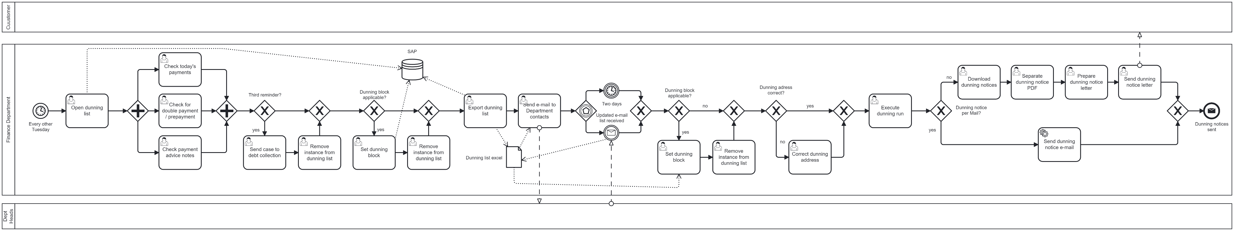
AS-IS Process
Dunning list preparation
Adjustment
Assessment dept heads
Review
Sending

Slide 4
Pain Points
Duration of the Process
Setting dunning blocks
Correction of dunning addresses
Export of the dunning notices sent by post
Notes:
The AS-IS process has inherent challenges and pain points. Our primary goal was to address and resolve the following issues.
The process runs from Tuesday to Thursday, and an employee of the finance department is involved on and off, which is inefficient.
The setting of dunning blocks requires involvement from various departments and is done fully manually, with a lot of back and forth.
Addresses of dunning notices need to be corrected in some cases. This correction is done manually.
Dunning notices sent via post need to be extracted from a PDF file containing all dunning notices. This extraction is done manually. These tasks are very time-consuming, inefficient, and prone to errors due to manual handling, considering there are around 300 positions per run.

Slide 5
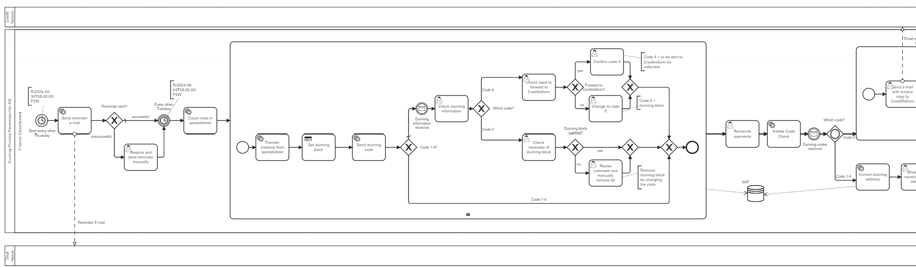
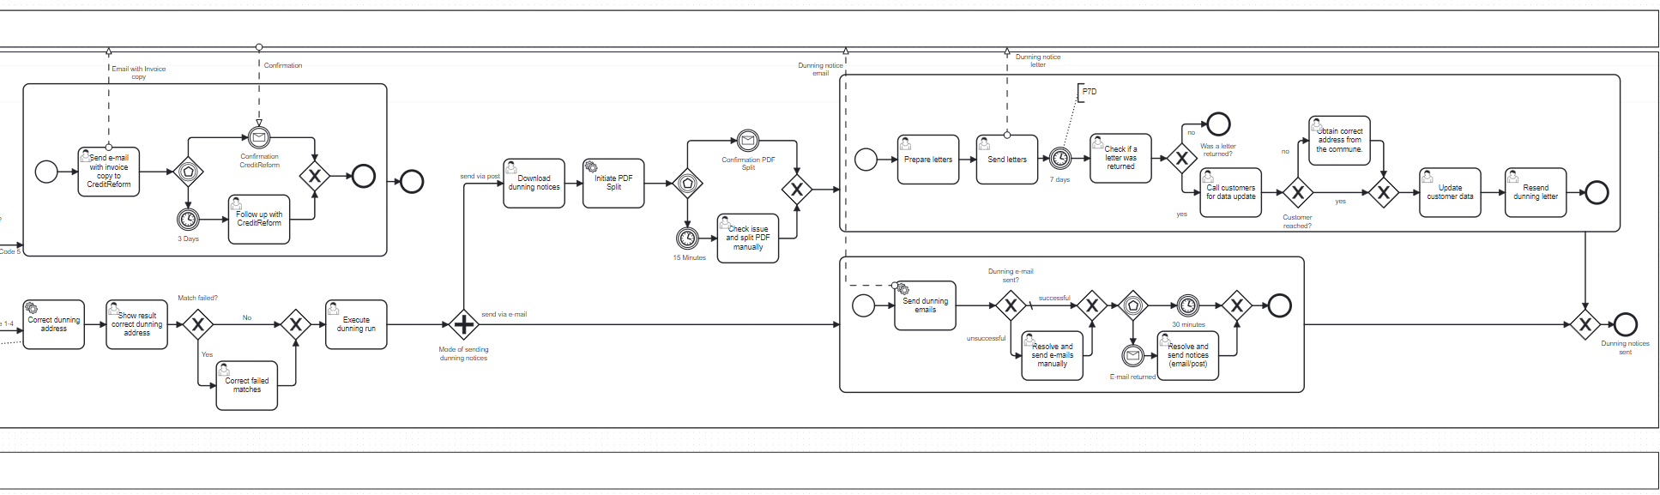
TO-BE Process
Reminder
Dunning block
Check Code
Debt collection
PDF splitting
Sending via Post
Address correction
Sending via e-mail
Notes:
We considered these pain points in our proposed process using automation, to speed up the process and reduce the risk of errors. As you can see, the process still looks similar, with some changes to the structure.
Firstly, we changed the start of the process by automating a reminder e-mail asking the department heads to add their dunning blocks directly in SAP. This is possible with a new role in SAP, giving them the right to make changes for this purpose.
As a result, the process for the finance departments only starts the following Tuesday and is performed within that one day.
Crucial parts of the process could be automated. The dunning block uses a decision table, and the address correction and PDF splitting could also be automated.
These changes allow the responsible employee to focus on the main tasks without being held up by repetitive manual jobs.

Slide 6
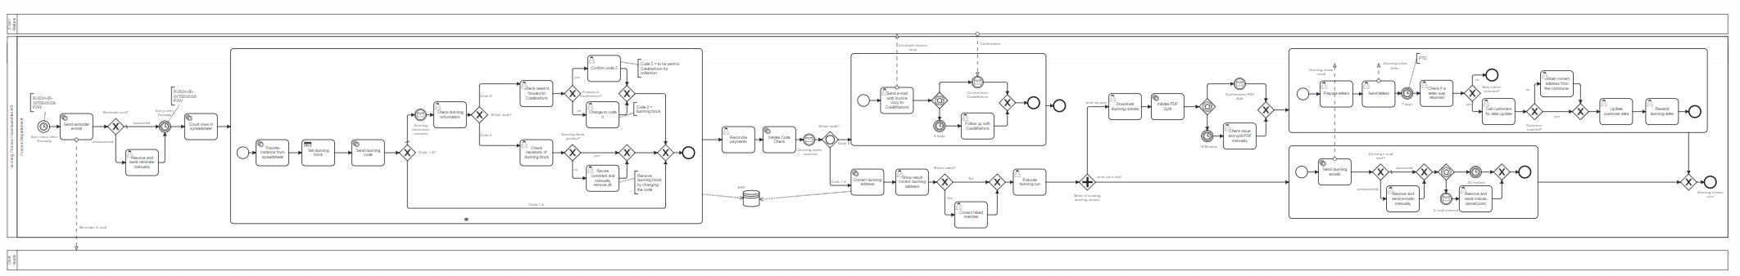




Dunning Block Decision
Set up of dunning codes and their meaning
Decision Making via Decision Table
Always up to date dunning list – due to automatic alignment
Most cases fully automated - exception Codes 0 and 5 need user checking

Slide 7
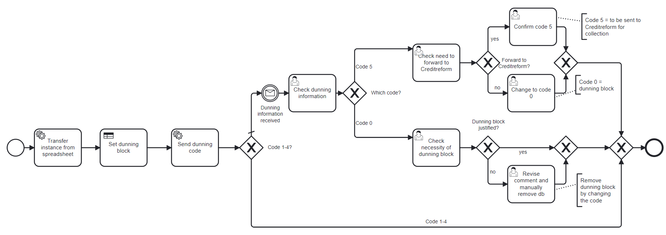
Dunning Block Decision
Set up of dunning codes and their meaning
Decision Making via Decision Table
Decision Table
Alignment dunning list
Always up to date dunning list – due to automatic alignment
Most cases fully automated - exception Codes 0 and 5 need user checking

Slide 8
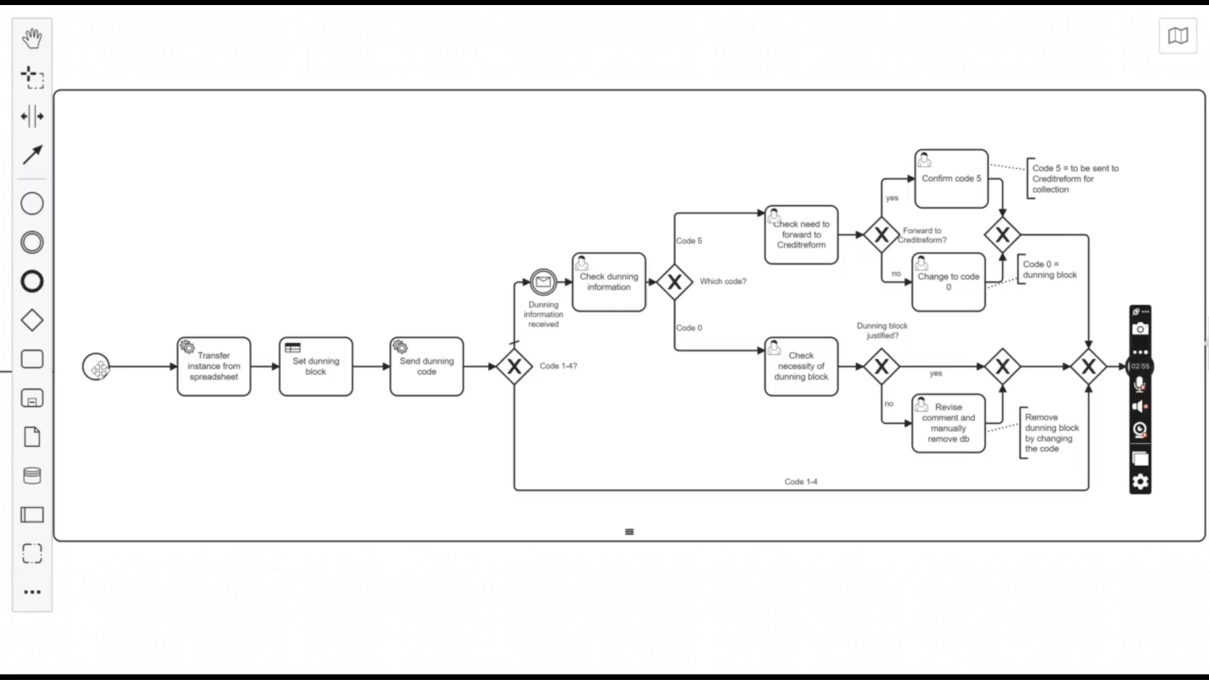

Slide 9
Address Correction
Invoice address ≠ dunning address
Automatic Address Correction
Reduction in Errors

Slide 10
Benefits of the new process
More efficiency due to faster processing
Less manual work
Fewer errors due to automation
Bundling the finance department process into one day instead of two
Notes:
Leveraging the automatic processing of many parts of the process allows Feuerwächter to have a more efficient process.
The automation reduces manual effort and the risk of errors, allowing them to focus on the most important parts, such as allocating the correct dunning code for more complex cases.
Furthermore, the changed start of the process could reduce the active processing time by more than half.

Slide 11
Thank you for your attention! Questions?

